Slide 1
7- Numbers

Slide 2
3 types of numbers
In python we have three types of numbers.
Integers
Floats
Complex numbers
complex numbers in math are in the form A plus

Slide 3
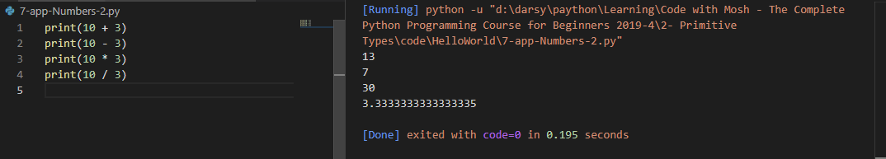
Operators
For all these types of numbers we have the standard arithmetic operations that we have in math.

Slide 4
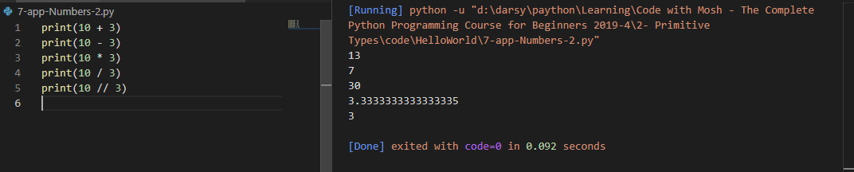
division types
/
we get a floating point number.
//
If you want an integer you use double slashes.

Slide 5
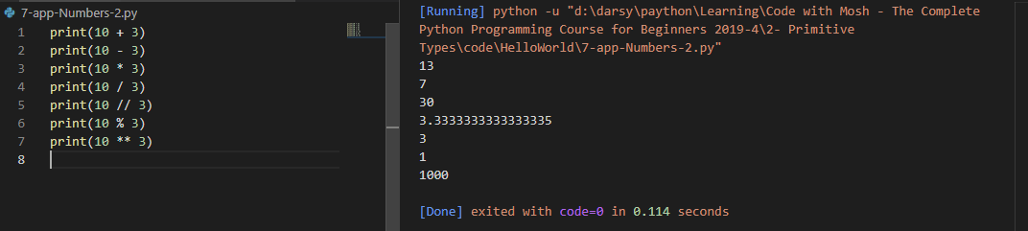
%
We also have modulus which is the remainder of a division.
And finally exponents which is left to the power of right. so

Slide 6
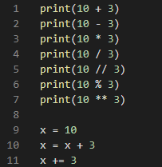
Augmented Assignment Operator
For all these operators we have a special operator called:
Augmented Assignment Operator

